Slide 1

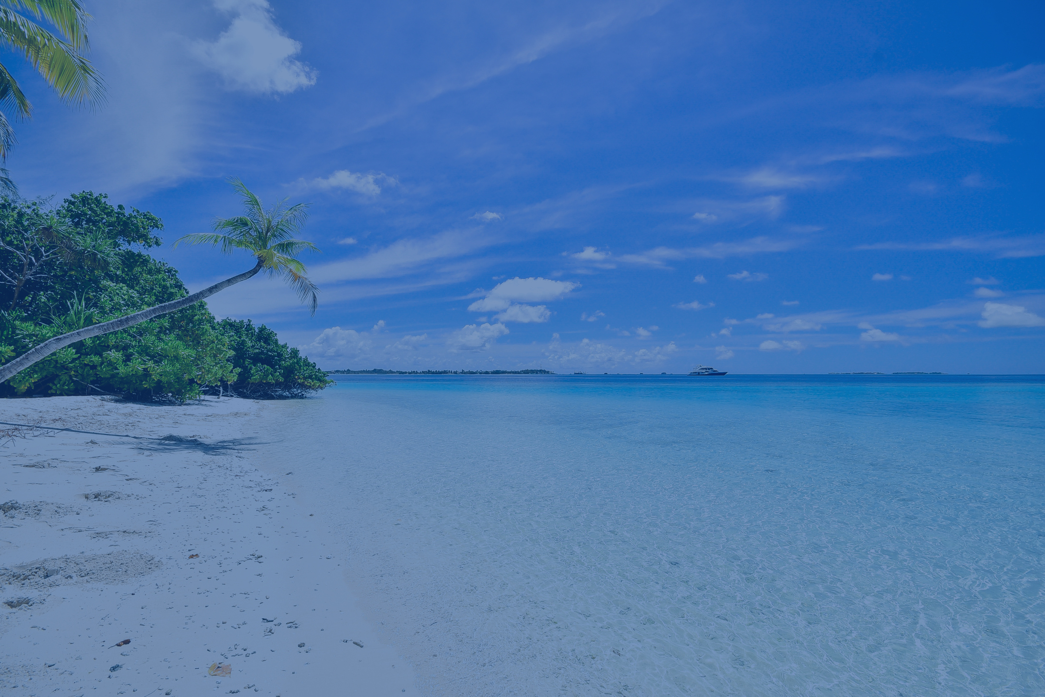


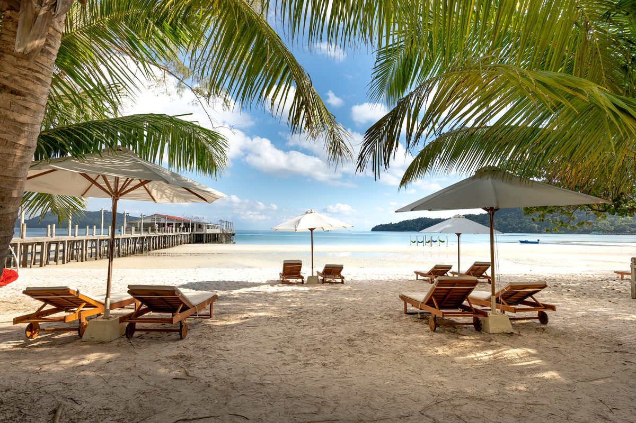
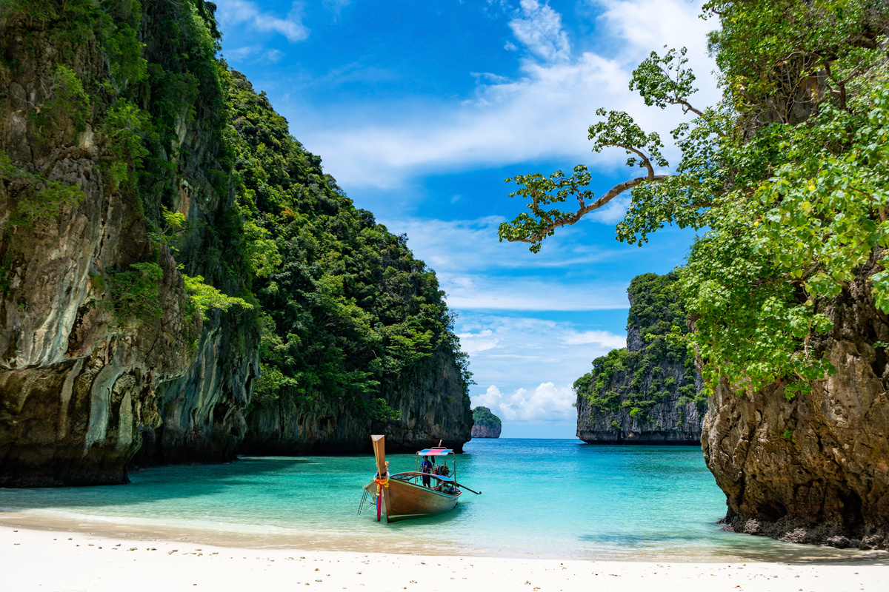

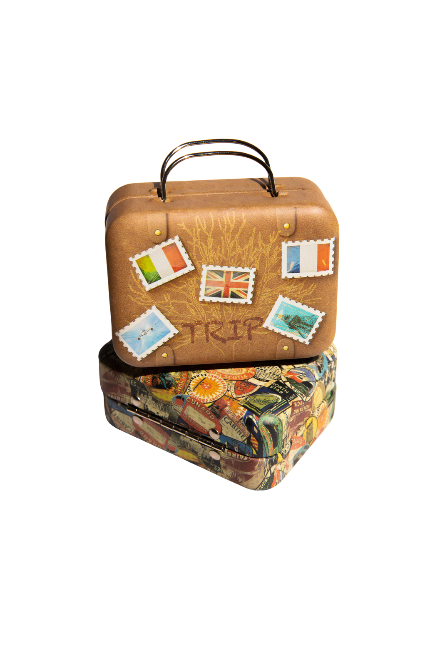
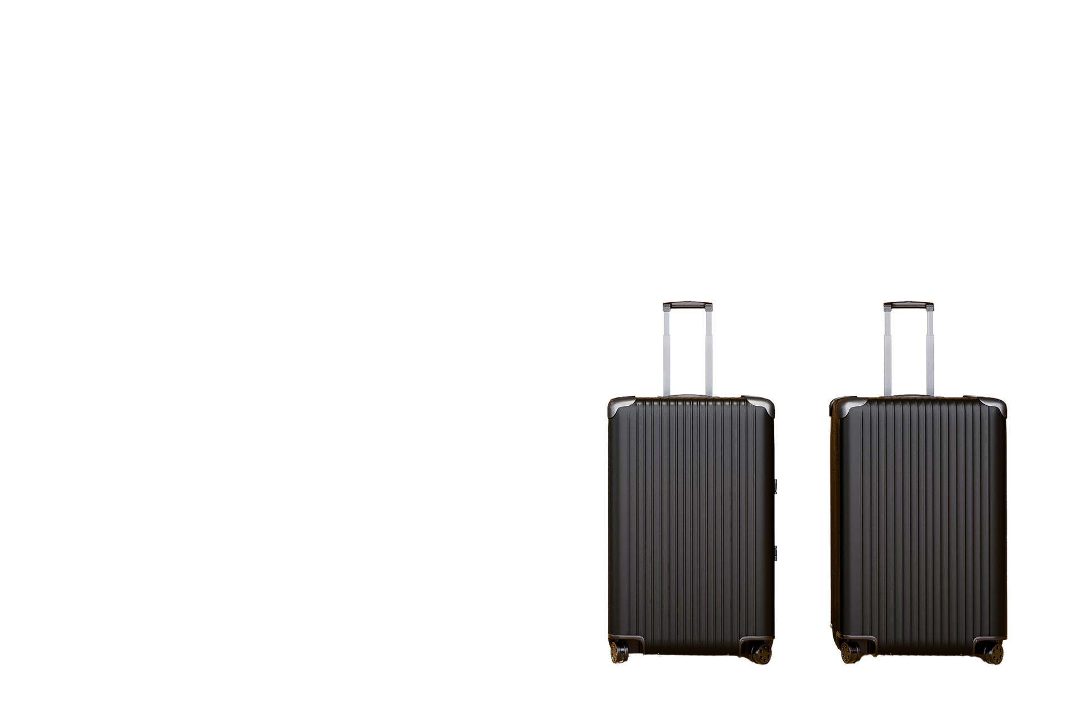
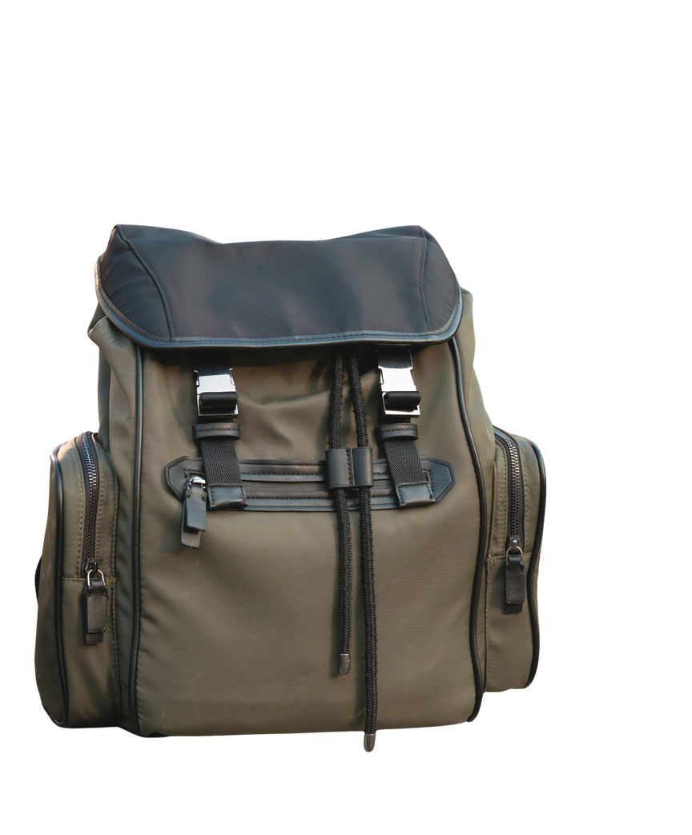
Dream
TRAVEL
Agency
.
Presented By:
Abu Bakar 2025-GA-99
Tahira Najeeb 2025-GA-110
Laiba Maqbool 2025-GA-101
M. Faiq 2025-GA-61
Fatima Waheed 2025-GA-88
Qudsia 2025-GA-69
Presented To:
Ms. Ramsha Khalid

Slide 2

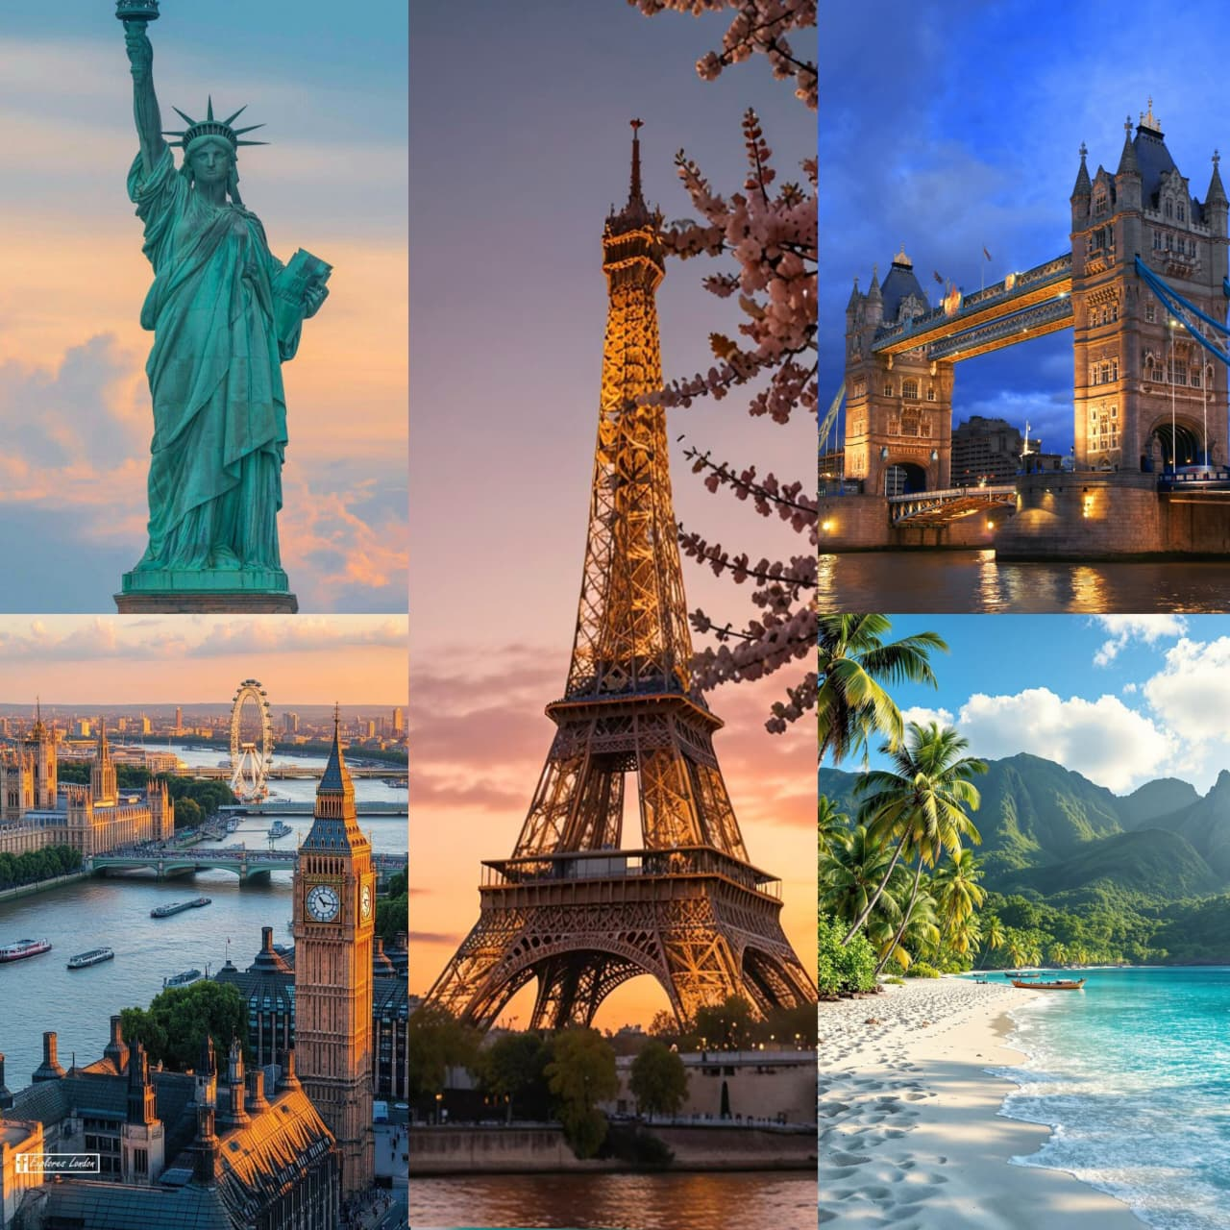

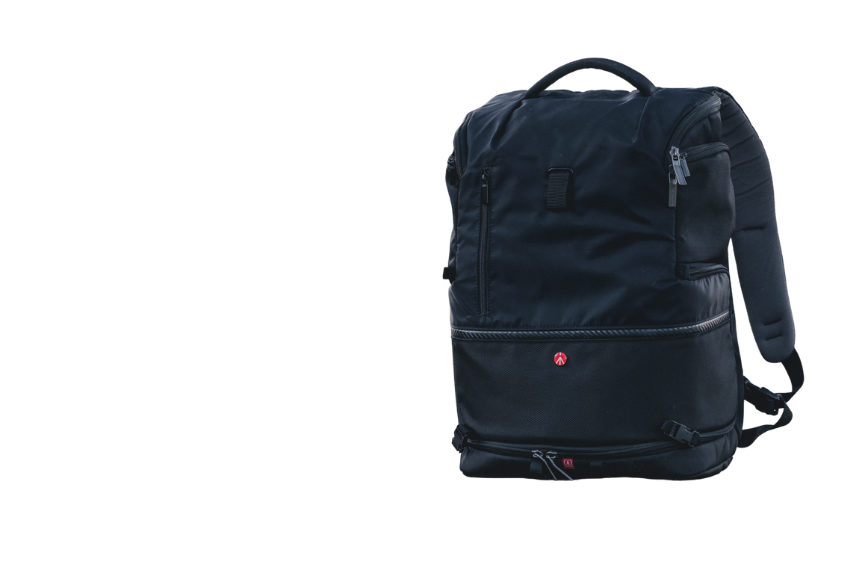
Project Objectives
To design a responsive travel agency website
To showcase travel destinations and tour packages
To analyze booking data using Microsoft Excel
To document the project using Microsoft Word
To manage and share source code using GitHub
To present the complete project using animation and video

Slide 3

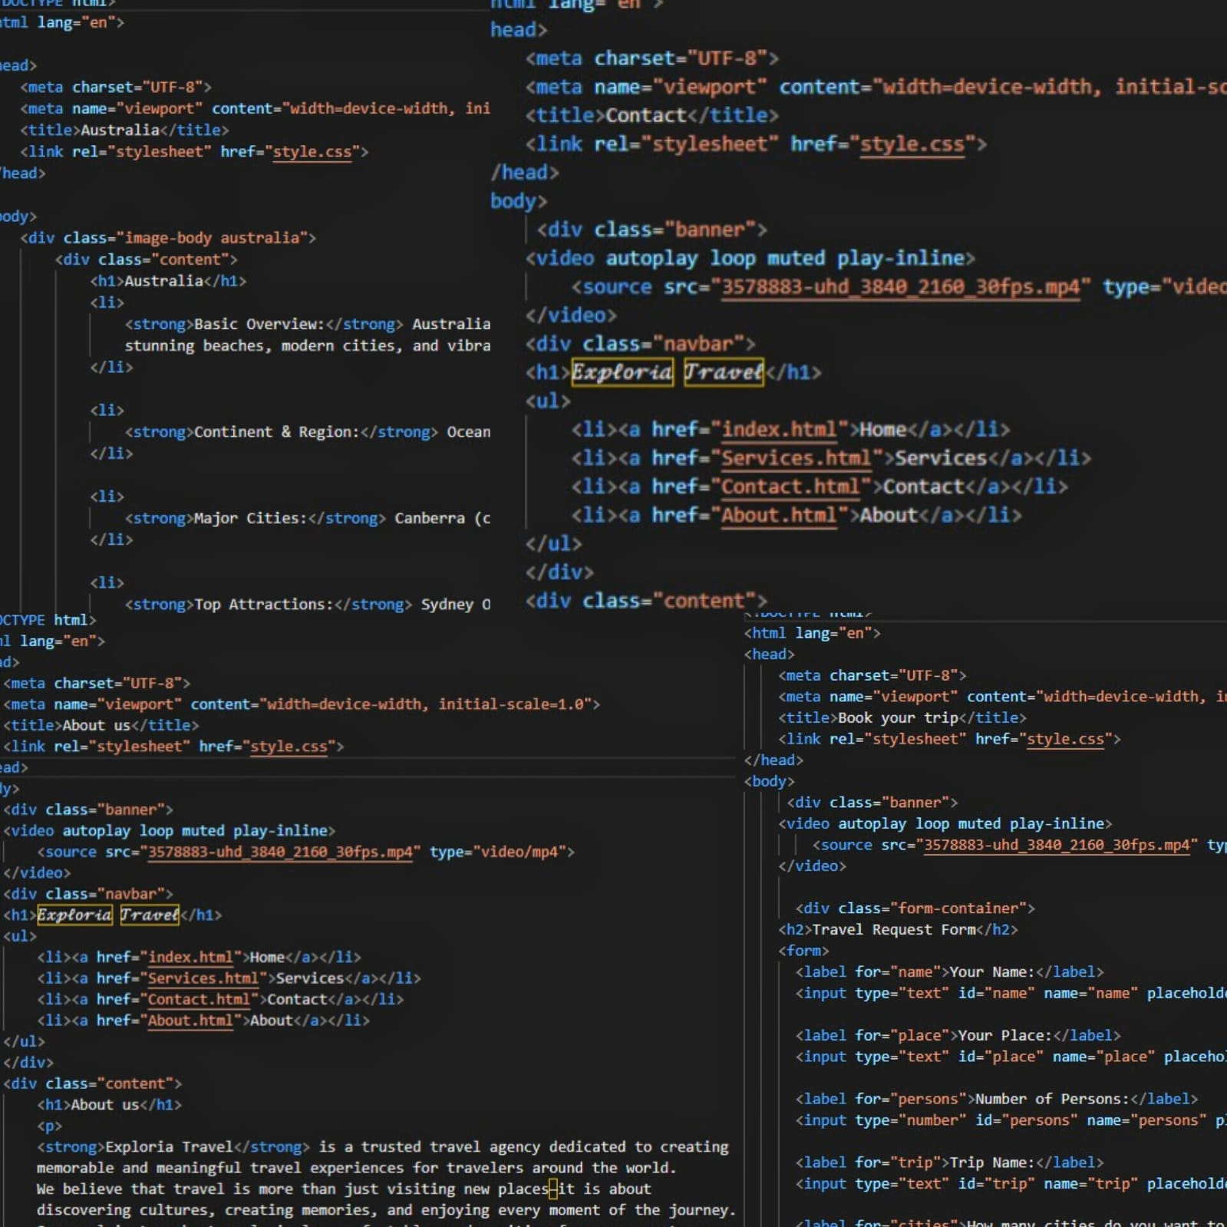
Website Overview
Dream Travel Agency is a demo travel website created to help users explore different travel destinations and tour packages. The website provides an easy and user-friendly interface for customers to view services and contact the agency.
Website Structure and code Design

Slide 4


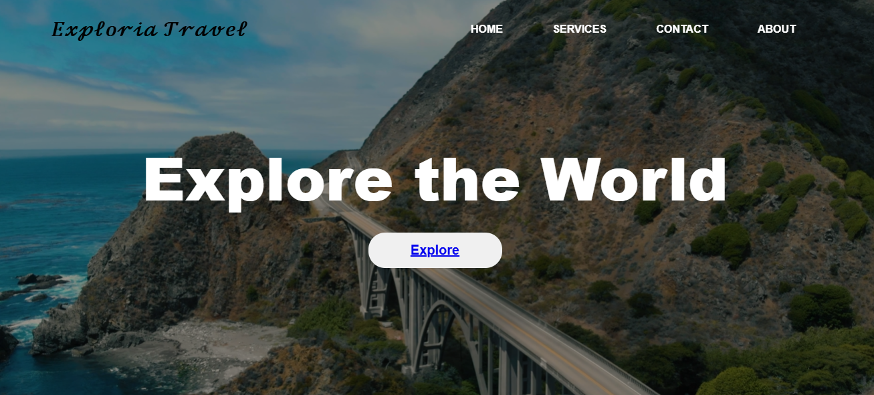
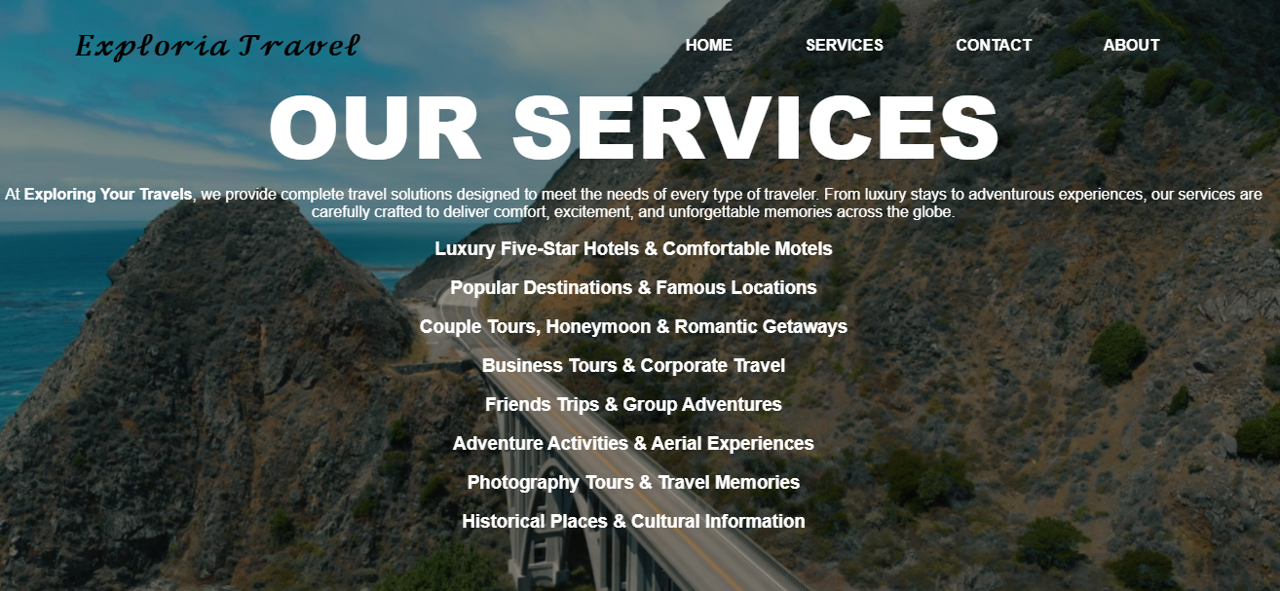
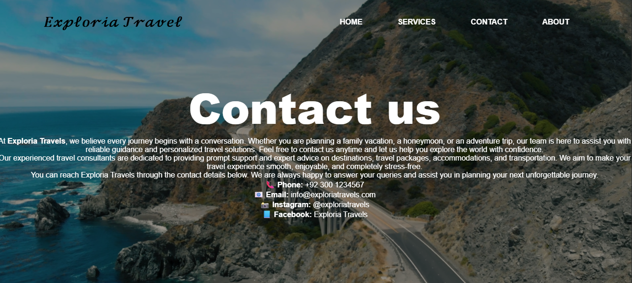
Website Demo
Home
Services
Contact
Home Page
Attractive hero section with travel theme
Highlights popular travel destinations
Easy navigation for users
.
Services Page
Displays different travel packages
Shows packages and details
Helps users choose suitable tours
Contact Page
Customer inquiry form available
Allows users to contact the agency easily
Displays basic contact information

Slide 5

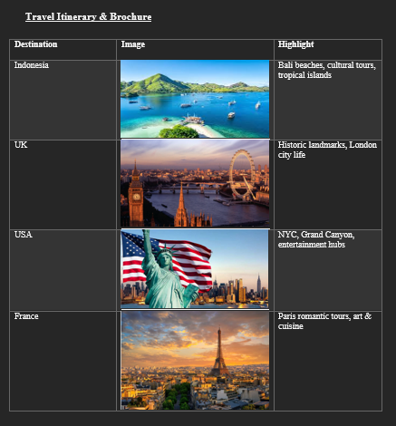
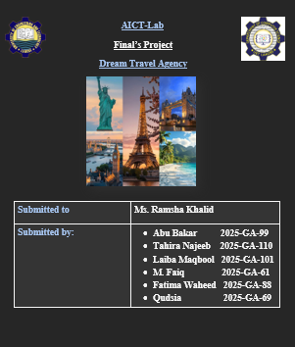
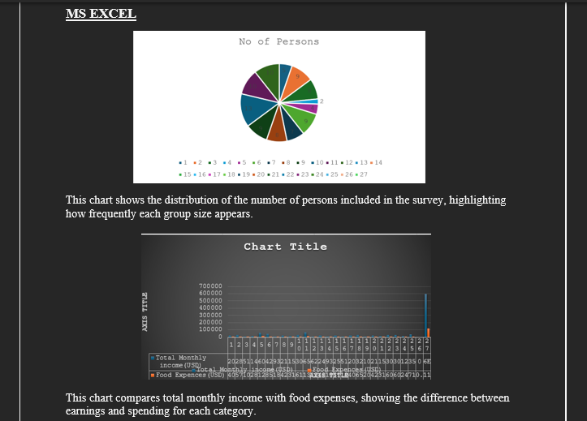
MS-word Documentation
The project documentation was created using Microsoft Word.
The document includes:
Project introduction and objectives
Website structure and key features
Summary of Excel data analysis & charts screenshots.
Links to the live website (GitHub Pages) and GitHub repository
Reference and link to the animated project demo video
LinkedIn profile link for professional project sharing

Slide 6

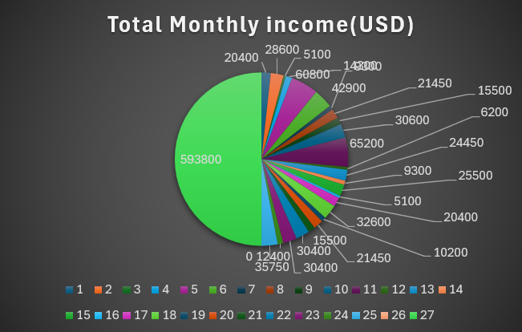
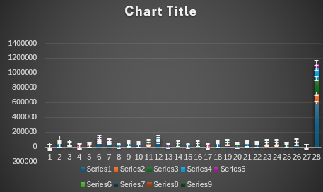
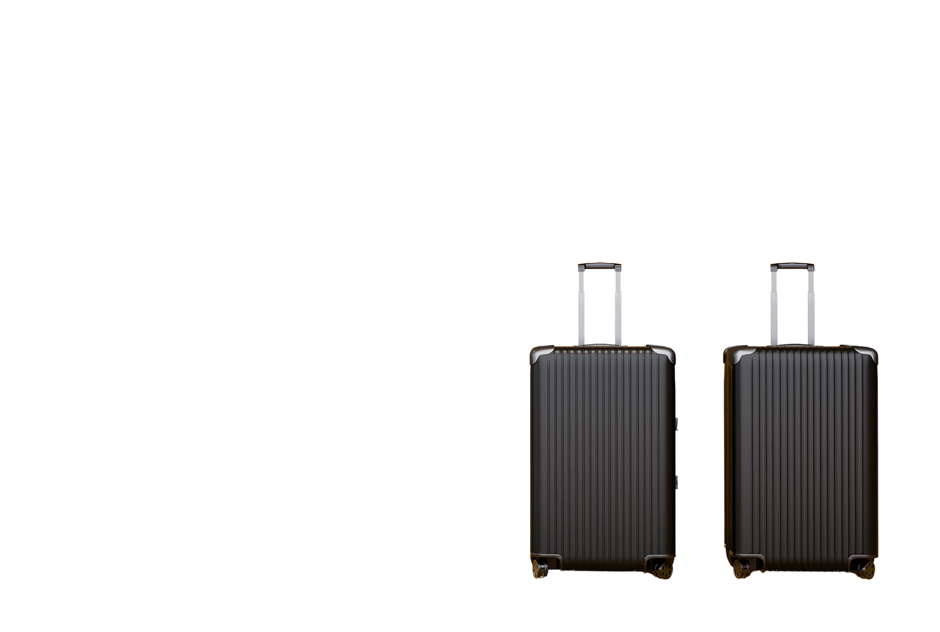
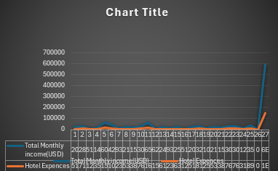
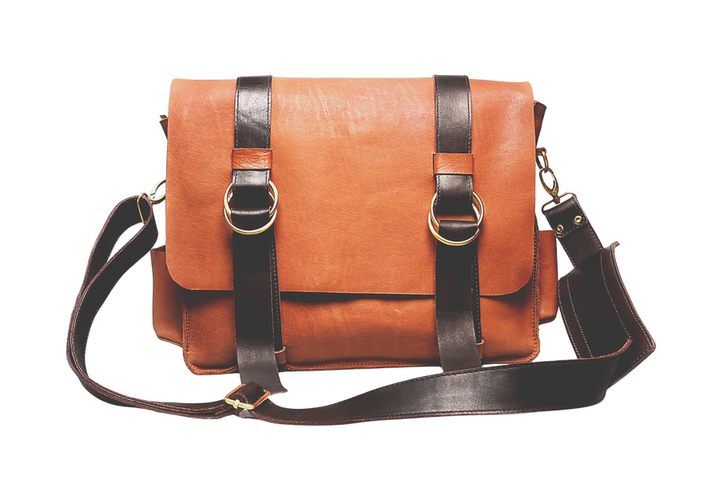
Excel Data Analysis
The Report Includes:
Microsoft Excel was used to analyze booking data
Travel data was organized in tables
A chart shows popular destinations and packages
Analysis highlights customer travel preferences

Slide 7

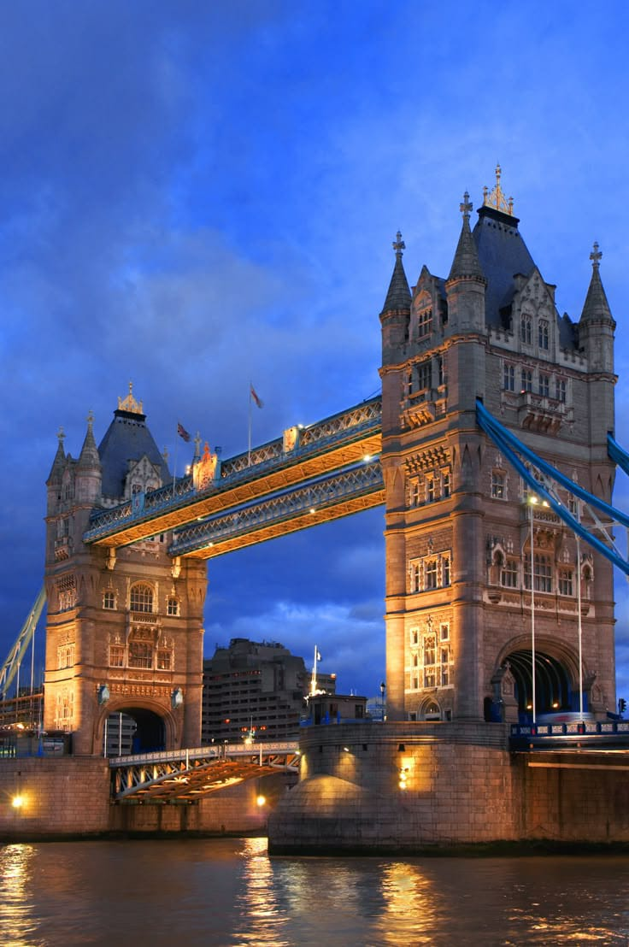
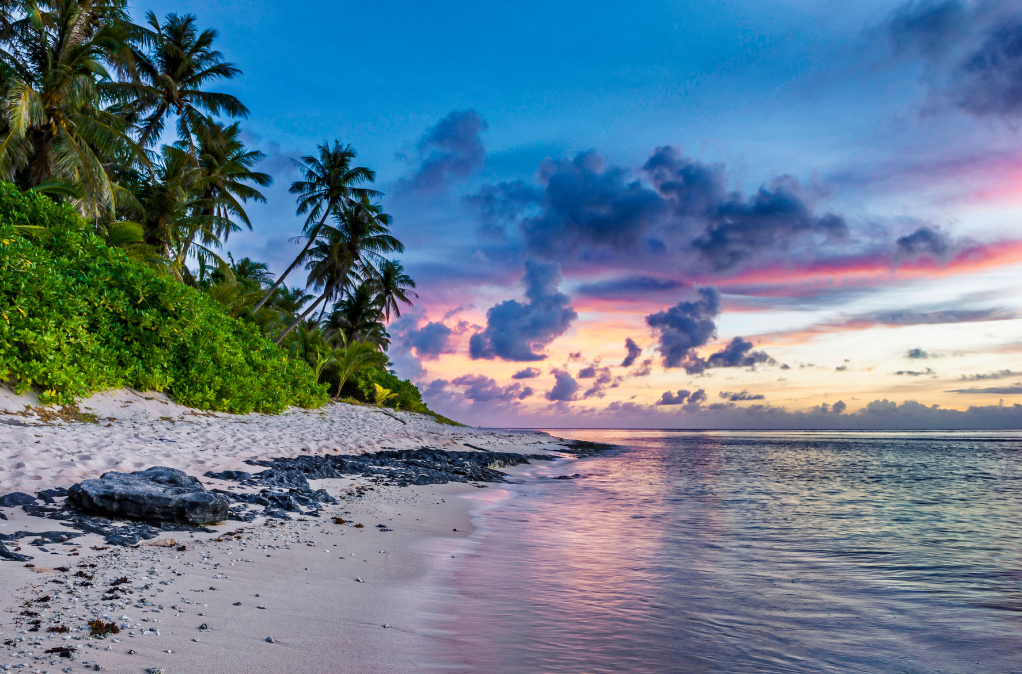
Design Decisions
A clean and simple layout was chosen for easy navigation
Travel-themed colours were used to create a pleasant user experience
Clear sections were designed for destinations and packages
Responsive design was used for mobile and desktop users

Slide 8

GitHub
We used GitHub to push my project files and deploy my Dream Travel Agency website using GitHub Pages. This helped me track changes and make my project accessible through a live link.
URL Links
https://github.com/tahirabutt/TravelAgencyWebsite.git
https://qudsiarizo24-hash.github.io/AICT-Final-Pro/
https://itxabbutt-hash.github.io/group-no-2-Dream-travel-agency/
https://github.com/laibamaqbool123/group-no-2-Dream-travel-agency.git
https://fatimahwaheed158-alt.github.io/group-no-2-Dream-travel-agency/

Slide 9
Home
About
Contact
LINKEDLN
The project was shared on LinkedIn for professional visibility
LinkedIn was used to showcase the project and skills
Helps connect with industry professionals and peers

Slide 10
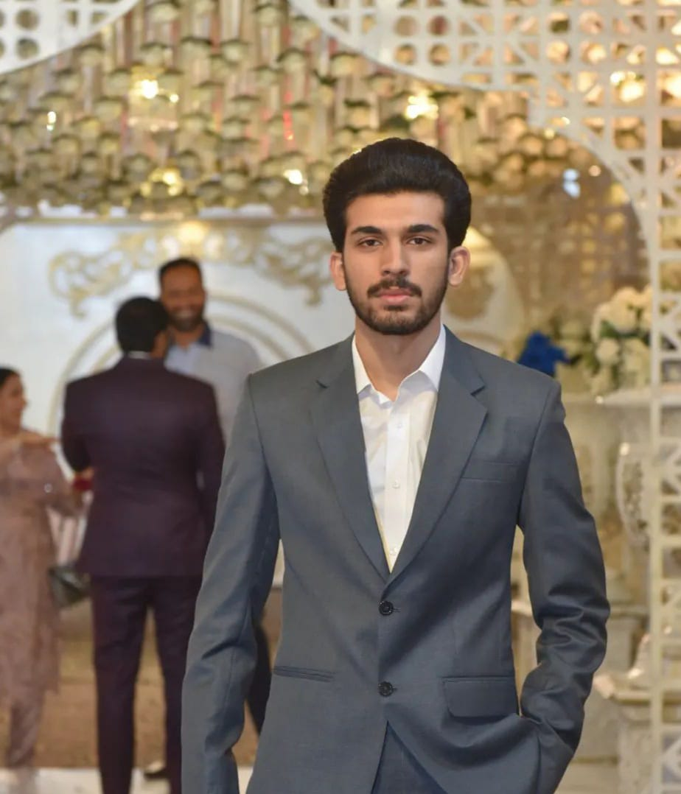
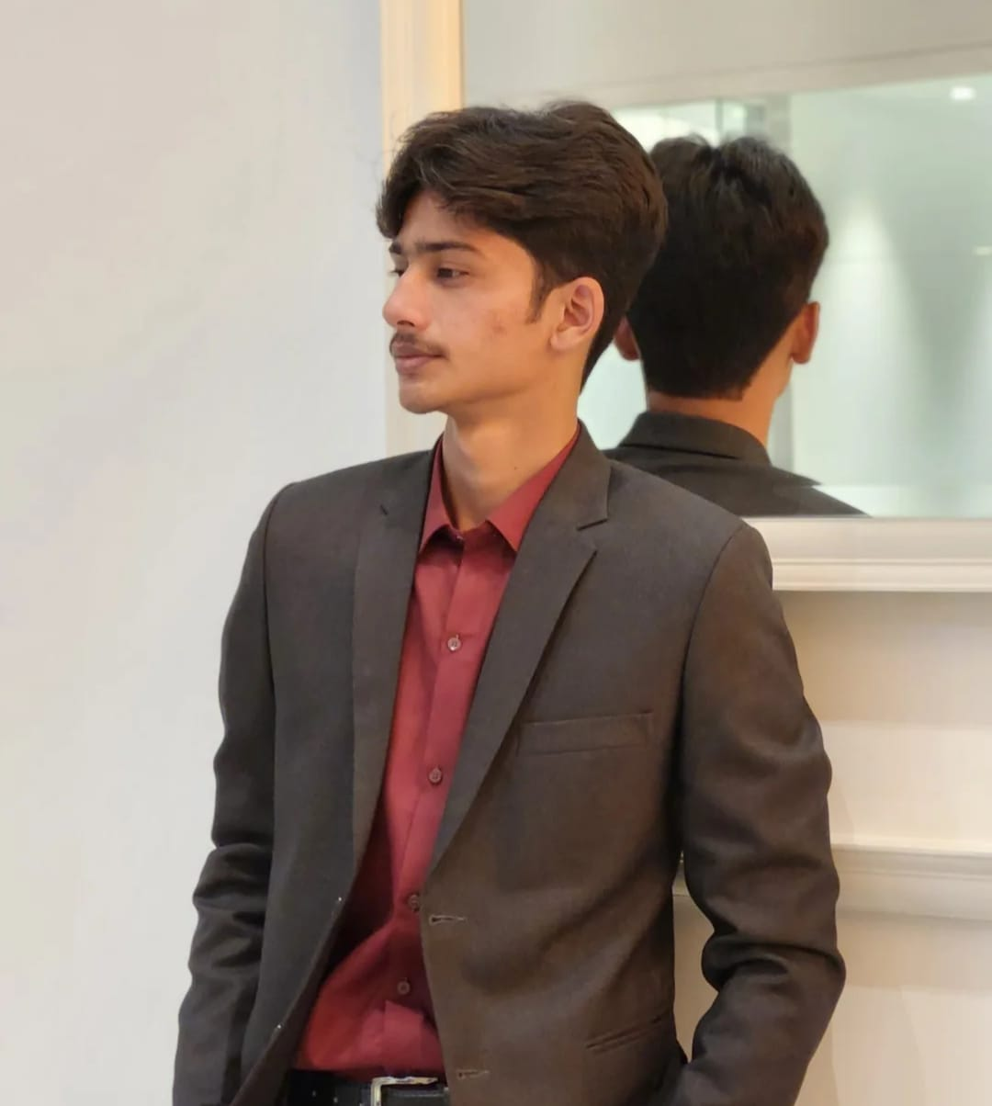
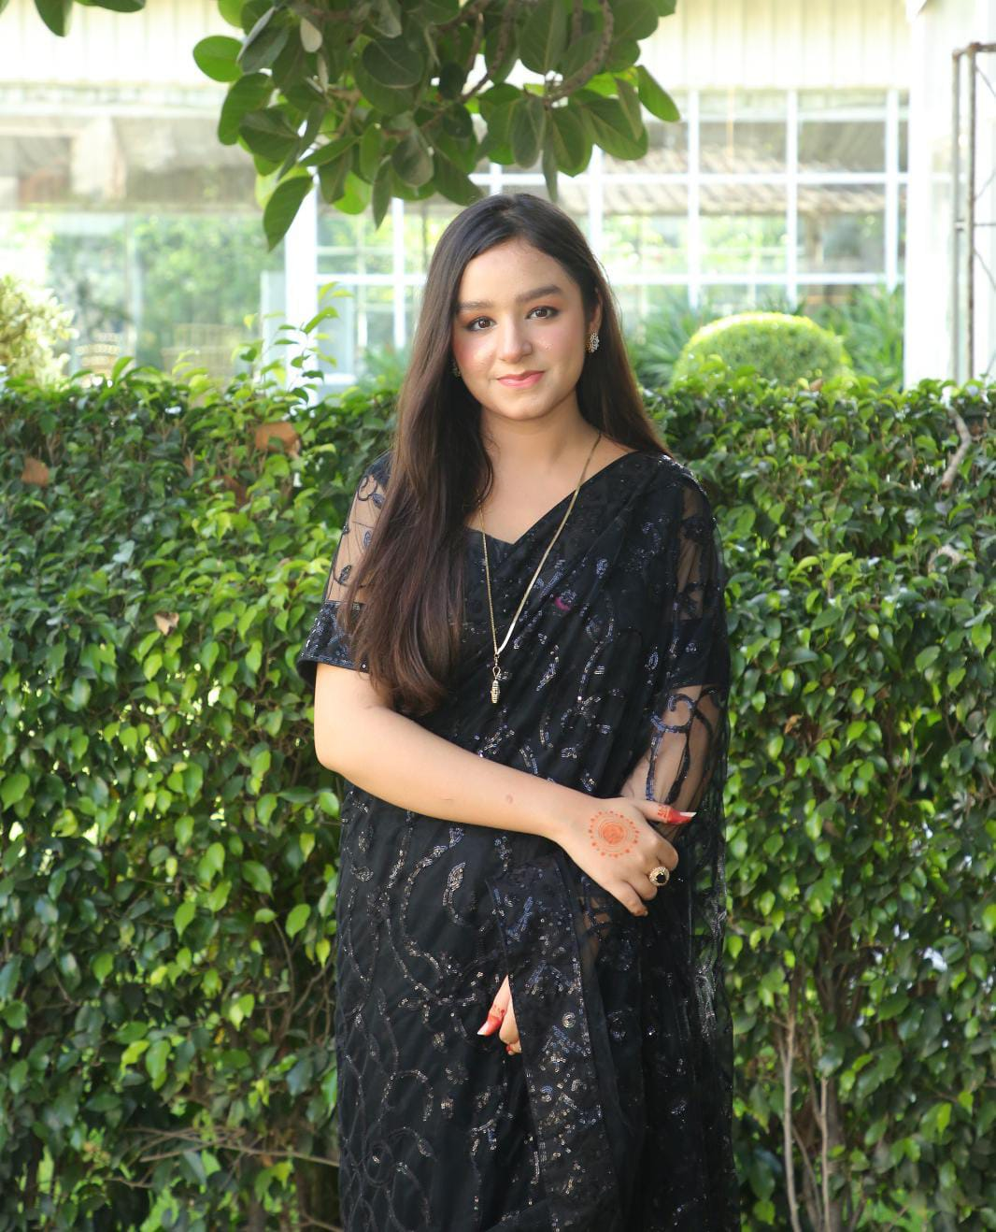
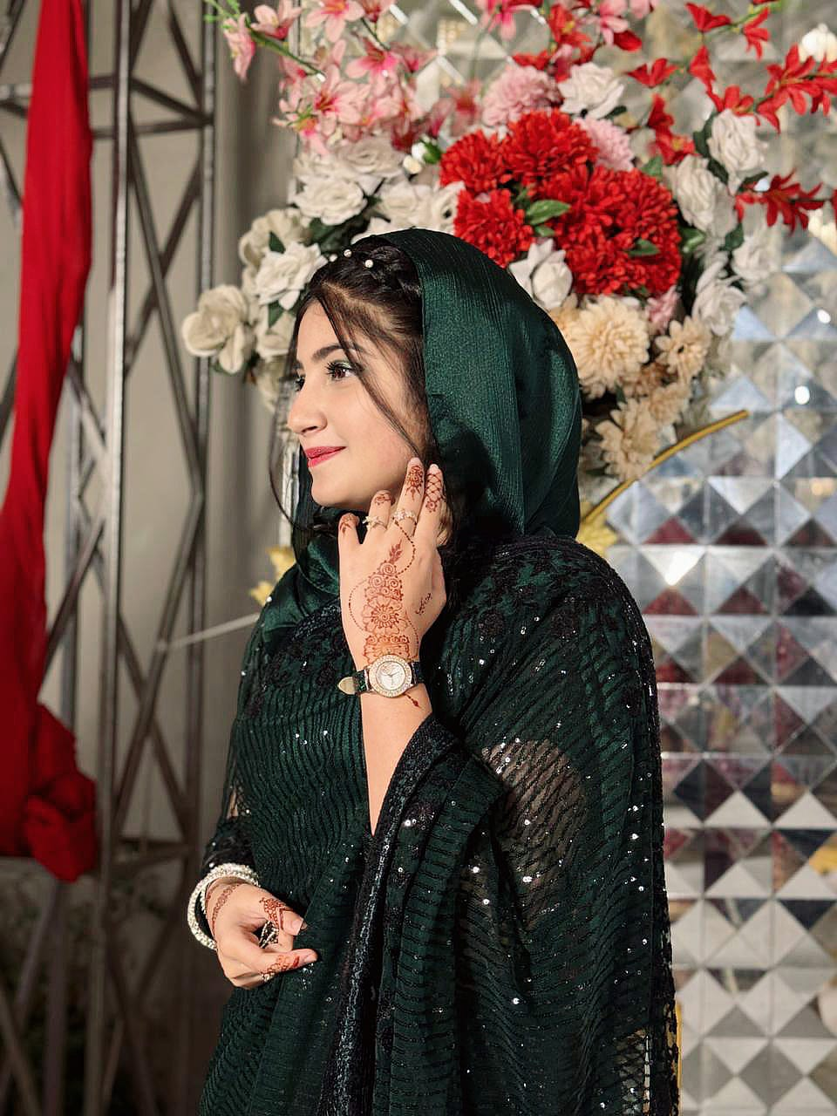
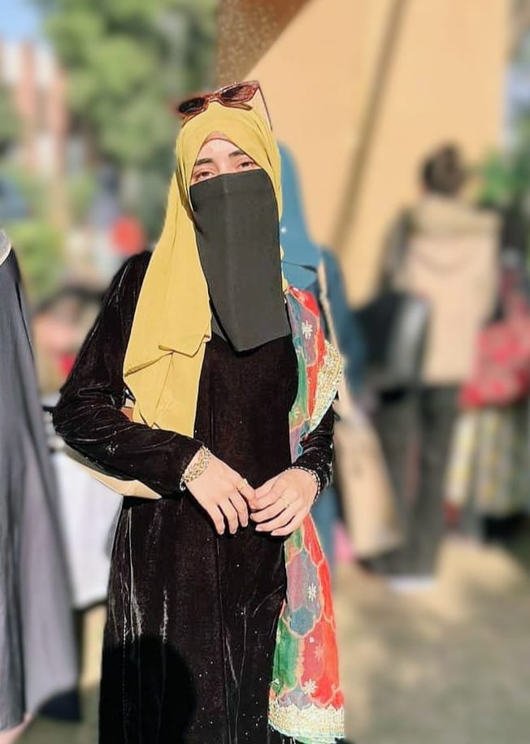

MEET OUR TEAM
Abu Bakar
GA-99
Faiq
GA-61
Fatima GA-88
Tahira GA-110
Laiba
GA-101
Qudsia
GA-69

Slide 11
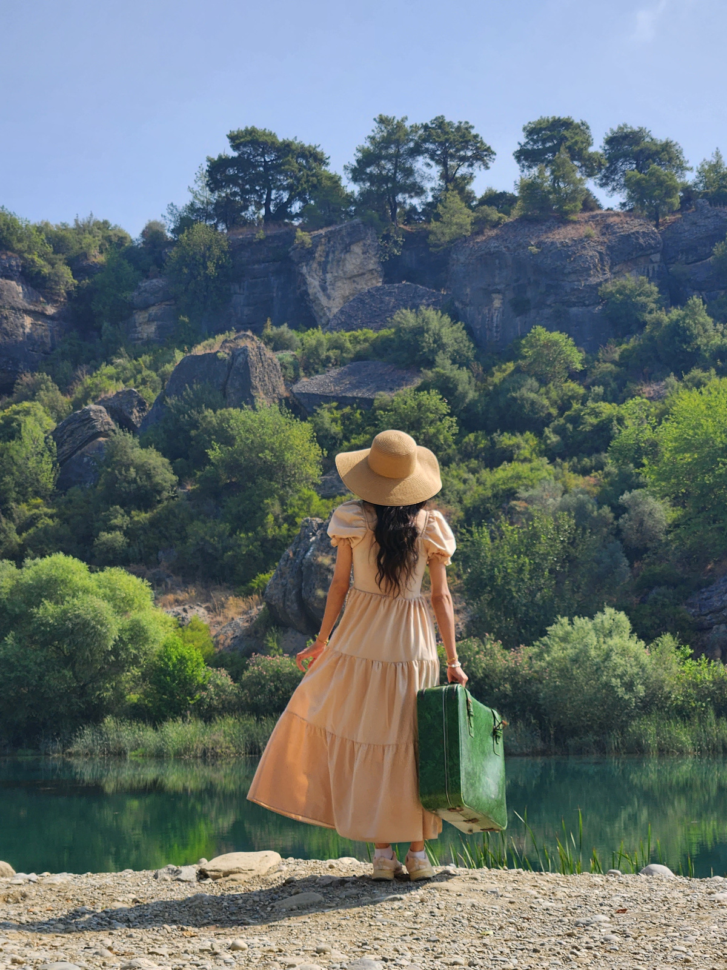




conclusion
The Exploria Traveler project successfully presents a simple and organized travel website for exploring destinations and packages. It integrates web development, Excel data analysis, documentation, GitHub hosting, and an animated presentation to demonstrate practical and professional skills.
Phone: +92 300 1234567
Email: info@exploriatravels.com
Instagram: @exploriatravels
Facebook: Exploria Travels

Slide 12
THANK
You
In accordance with the
instructions of Ms. Ramsha Khalid
all project work was
completed collaboratively
by the team members: Laiba Maqbool
Tahira Najeeb
Qudsia
Fatima Waheed
Abu Bakar Butt
Muhammad Faiq

